Slide 1
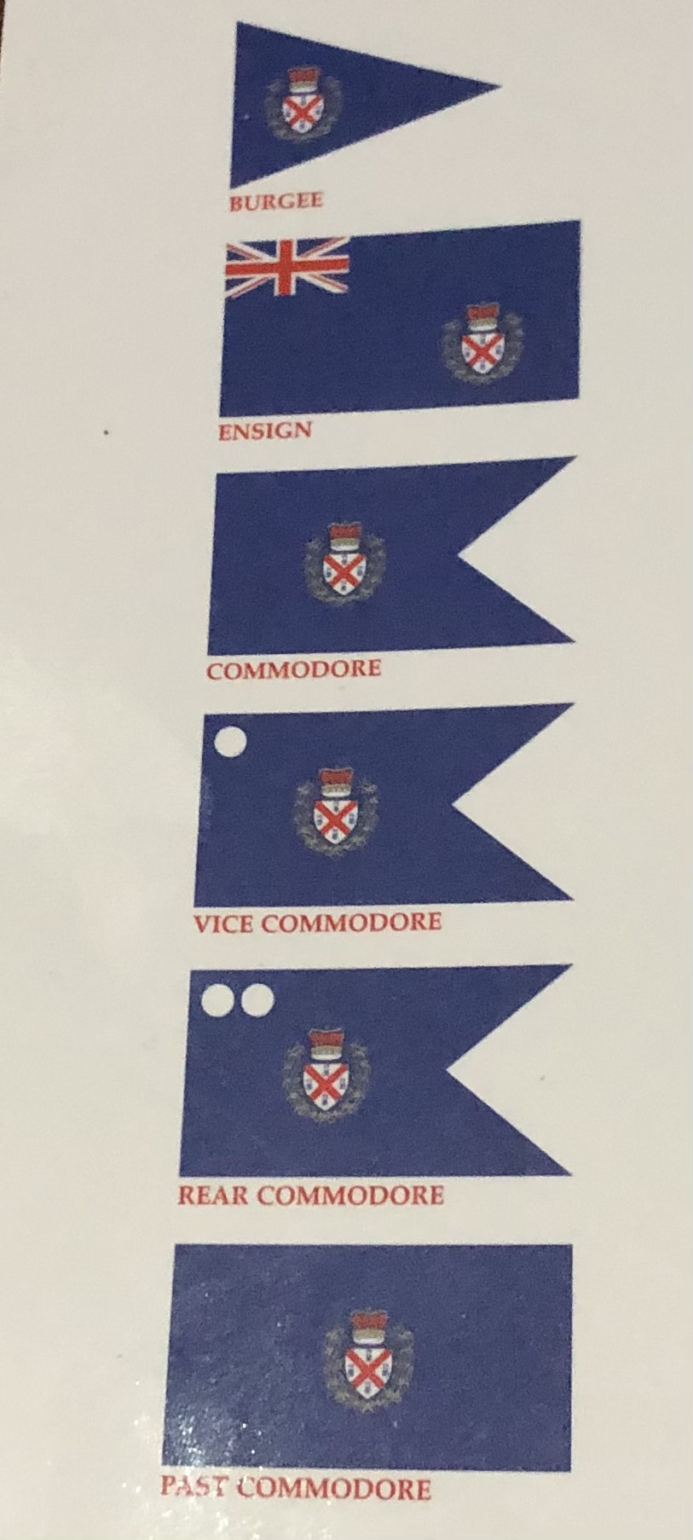
Royal Plymouth Corinthian Yacht Club Limited
FLAGS ORDERED TO BE BORNE BY THE ROYAL PLYMOUTH CORINTHIAN YACHT CLUB
By Warrant from the Lords Commissioners of the Admiralty, dated 9th June 1893.
Founded 1877
COMPANY BYE-LAWS
Published 2021
25 The Parade
Plymouth
PL1 2JN
Tel: 07920233621
Tel:01752 466246
Email: Info@rpcyc.co.uk
Ltd
Royal Plymouth Corinthian Yacht Club Ltd incorporated in England and Wales. Registered number 08220368, a company limited by Guarantee. Registered Address, 25, The Parade, The Barbican, Plymouth. Devon. Pl1 2JN

Slide 2
The following Regulations have been agreed by the Directors and Flag Officers of the Company and are in accordance with the Articles of Association, a copy of which is available on request to members.
1. CLUB BURGEE
The Club Burgee shall be blue with a white shield, between a red cross of St. Andrew, four black castles surmounted by an Imperial Crown and garlanded by a gold laurel.
2. COMPANY DIRECTORS
The affairs of the club shall be overseen by the Company Directors whose duties will include regular review of the finances of the club, ensure the members interests are looked after and fulfil the legal requirement to file such reports as required by Company House. Rules concerning their appointment and length of term can be found in the Articles of Association.
3. CLUB FLAG OFFICERS AND OFFICIALS
The Officers of the Club shall be Flag Officers: Commodore, Vice-Commodore, Rear Commodore Sail, Rear Commodore House and Club Officials: Honorary Secretary, Honorary Treasurer and Honorary Membership Secretary. The Commodore will be invited to become a Director and shall not serve a term longer than three consecutive years unless in exceptional circumstances as agreed by the Directors. They shall not be eligible for election to that office after retirement until two years have passed. All Flag Officers and Officials will be elected annually at the AGM. The Club Officers shall be responsible for the operational running of the Club. They are answerable to the Directors and shall report quarterly to the Directors. They shall not without written permission from the Directors:
Make any changes to Club Banking arrangements
Make any changes to Club Insurance arrangements
Sell any Club Assets
Amend any Leases entered into by The Club
Purchase Goods of a Capital nature (an Asset) with a value greater than £5000
4. GENERAL COMMITTEE (GC)
The General Committee will consist of the Officers of the Club and up to 12 Full Voting Members. Each year ¼ of Members in rotation of seniority of continuous service on the GC shall retire and vacancies shall be filled by election at the AGM. Any Officers of the Club not re-elected and the retiring GC Members shall be eligible for re-election to the GC. Any GC Member being nominated for election as Flag Officer or Officer must resign from his/her post on the GC on submission of his/her nomination.
The names of the Officers and of the members nominated for election to the GC must be proposed in writing to the Honorary Secretary and posted on the notice board seven days before the AGM.
25. CLUB FUNCTIONS
All tickets must be paid for at least three days before the event takes place, there will be no refund for non-attendance.
26. FOOD
Members may bring in food, including from local takeaways, members may use the microwave and refrigerator. Crockery and cutlery will be available. It is the members responsibility to clear away after themselves and guests.
27. PETS
Well behaved dogs are allowed in the Club, it is the owners responsibility to keep them under control.
28. MOBILE PHONES
Mobile phones may not be used in the Cockpit Bar or Saloon..
29. SMOKING AND VAPING
In order to comply with the Law and the Club Bye-Laws Smoking and Vaping is not permitted anywhere on the Club Premises or immediately outside of the building.
30. CHILDREN AND CADET MEMBERS
Children must be in the care of a responsible adult who shall be responsible for their behaviour at all times whilst in the Club. All Children must vacate the premises by 21:00 at the latest.
The Committee is anxious not to restrict members bringing in children however may withdraw the privilege unless parents exercise control over their children, for their safety and to enable the enjoyment of the premises by other members.
31. MEMBERS AND GUESTS SIGNING IN
All Members must swipe their membership card on entry, or sign in, if they do not have their card, on each occasion they visit the club. No person may be admitted as a guest to the club house more than three times in any one calendar year, except on such occasions as may be sanctioned by the responsible person. Every member introducing a guest to the club house must enter the guests name and address in the book provided for that purpose, at the same time entering his/her own name as introducer. Each Full Voting Member may only admit a maximum of 2 guests at any one time.
EXCEPTIONS TO THE RULES
Any case not provided for by these rules shall be referred to the General Committee whose decision shall be final.

Slide 3
19. DAMAGE TO COMPANY PROPERTY
A member may not knowingly remove, injure, destroy or damage and property of the Company and shall make restitution for the same if called upon to do so by the GC.
20. NEIGHBOURS
Members shall respect the Clubs’ neighbours by arriving and leaving the Club quietly, particularly late in the evening and by leaving the street and pavement clear of any refuse.
21. DETERMINATION OF SUBSCRIPTION RATES
The appropriate joining fee and subscription shall be as determined by the Flag Officers and Officers, approved by the Directors and signed off by the Members at a General Meeting.
Changes to Subscription Fees shall be made for the start of the next membership year, January 1st after the AGM. Any member elected part way through the year shall pay their current monthly subscriptions until such time as they reach their annual renewal date
22. PAYMENT OF FIRST SUBSCRIPTIONS
A member shall participate in any privileges of the club after the first monthly payment of the subscription has been received and after 2 full days of being accepted as a member. If this application fails all monies paid will be refunded.
23. MAINTENANCE OF THE YACHT REGISTER AND WARRANTS
Every yacht or boat belonging to Members shall be registered with the Rear Commodore Sail, such register to state type, name, rig, dimensions and tonnage (or class) of each vessel with the owner’s name. This shall be done on the yacht owners election as a member.
Members whose boats meet the requirement may apply for a Warrant to Fly the defaced blue ensign. Once the Warrant has been received members may purchase Ensigns from the Club. Members who do not have Warrants may fly the Club Burgee which is available to purchase from The Club. Should anyone resign their membership they must return their Warrant to the Club and will no longer be authorised to Fly the Blue Ensign
24. SKIPPER AND MEMBERS ACCOUNTABILITIES WHEN SAILING IN COMPANY
Skippers Duties: Each Skipper at all times is responsible for the safety of the boat, crew and safe pilotage, has valid insurance and is responsible for his/her decision to put to sea for any leg of a cruise. The events and activities listed are only to provide as a suggestion to those wishing to sail in company and the RPCYC cannot be held responsible for the safety of individuals who choose to take part.
25. LICENCING HOURS
The permitted licensing hours for the supply of intoxicating liquor on Club premises are in accordance with the Club Licence and will be displayed within the Club.
The GC can appoint the following sub-committees and any others as they see fit:
The Sailing Sub-Committee which shall control all matters appertaining to sailing under the burgee of the club.
The Bar and Social Sub-Committee which shall be composed of at least four full voting members and will be responsible for the stocking and running of the bar, and organise social events for the benefit of the club
The House Sub-Committee will be responsible for he maintenance of the premises and for keeping the official inventory
d) Sub-Committees for may be appointed from time to time by the GC.
5. DEFAULT OF COMMITTEE MEMBERS
Any members of the General Committee unless unavoidably prevented by illness or any other satisfactory reason, who fails to attend two-thirds of the meetings during the year will not be eligible for election the following year.
6. QUOROM IN GENERAL COMMITTEE
General Committee meetings shall be held when required, five members including a mixture of Flag Officers and Committee Members to form a quorum.
7. VACANCIES For CLUB OFFICERS, OFFICIALS and GENERAL COMMITTEE
Vacancies may be filled by the Club Officers and Officials, at their discretion, until such a vacancy is filled by election in accordance with Bye-Laws 3 and 4 at the next AGM.
8. GENERAL MEETINGS OF FULL VOTING MEMBERS
General Meetings Full Voting Members of the Club shall be held at such time and place as the Clun Officials appoint, of which a minimum of fourteen days notice must be given to all members entitled to vote. Notice shall be deemed as having been given if notice is posted to any Member’s last known postal or email address. There must be a General Meeting once a year and fifteen months must not elapse without a General Meeting.
Any Member who wishes to move a motion at the meeting will give notice in writing or by email to the Honorary Secretary at least seven days before the date of the meeting and notice posted at the Clubhouse.
A Special General Meeting may also be convened under a requisition signed by one of the Flag Officers, Director or by not fewer that ten Members and specifying the objective of the proposed meeting. At all Special Meetings a Chairperson shall be chosen by the Members present ten Members shall form a quorum.
Should there be exceptional circumstances, whereby members cannot meet in person, any meeting shall be held by alternative means such as by virtual meeting or conference call at the discretion of the board of Directors.
.

Slide 4
9. CONDUCT OF ANNUAL GENERAL MEETING (AGM)
At an AGM ten Full Voting Members shall form a quorum.
The Chairperson at an AGM shall be the Commodore, the Vice Commodore, or in their absence, a Chairperson elected by those Members present and eligible to vote.
10. PRESENTATION OF PROPOSITIONS
No proposition related to any matter shall be brought forward to an AGM or any General Meeting unless previously notified to the Honorary Secretary in writing and posted in the Club House for a minimum of seven days before the meeting
VOTING AT A GENERAL MEETING (GM)
Only Full Voting Members of the Club shall be entitled to vote at a General Meeting of the Club whereby all voting will be by a show of hands. The exception will be upon the election of Members of the General Committee which shall be by ballot if posts are contested, in the case of equality of votes the Chairperson shall have a second or casting vote. Junior Members may attend GMs but are not permitted to vote.
ELIGIBILITY TO PARTICIPATE IN CLUB AFFAIRS
No Member shall be allowed to take part in any debate or proceedings of the Club or to enter or steer a yacht for any prizes given by the club until his/her subscription payments are up to date and all other sums of money he/she may owe to the Club have been paid
13. BYE-LAW CHANGES
The bye-laws of the Club may be altered from time to time by the Club Officers and officials and agreed by the directors
HONORARY MEMBERS
Honorary Members shall be elected annually at an AGM and shall not exceed at any one time a significant proportion of the total number of Members
15. REGISTER OF MEMBERS
Every Member must furnish the Honorary Membership Secretary with an up-to-date address which shall be recorded in the Register of Members and any notice sent to such address will be deemed to have been duly delivered.
16. DATA PROTECTION ACT 2018 and GENERAL DATA PROTECTION REGULATION 2018
The club is registered under the provisions of the Data Protection Act 2018 (or any successor statute) and is in consequence required to observe and be bound by the regulations prescribed thereby from time to time. Membership of the Club will imply deemed consent on the part of any Member of the Club for the Purposes of section 32(2) and 32(3) of the said Act. Members may request a copy of The Club Privacy Policy from the Honorary Secretary
.17. GRADES OF MEMBERSHIP
FULL VOTING MEMBER : Any person over the age of eighteen, who on paying the appropriate subscription, shall be entitled to attend meetings of the Club, vote at ballots on any matters concerned with the management of the Club, be entitled to share in the property or profits of the Club on dissolution and also enjoy the full facilities and privileges of the club.
COUPLES/FAMILY MEMBERSHIP: This Membership is for two adults who will both be Full Voting Members and are both over the age of eighteen, who on paying the appropriate subscription, shall be entitled to attend meetings of the Club, vote at ballots on any matters concerned with the management of the Club, be entitled to share in the property or profits of the Club on dissolution and also enjoy the full facilities and privileges of the club. It also includes as Junior Members those children under the age of 18 (or 21 if still in full time education. They are Non Voting Members and shall not be entitled to a share in the property or profits of the Club on dissolution.
CADET MEMBER: Persons between the ages of 11 and 18 (or in full time education) may be admitted as Cadet Members, subject to their being elected in the same manner as Members. They shall not be entitled to stand for the position of Flag Officer, Club Officials or General Committee Members, they may be elected as Sub committee Member other than for the Bar Sub- Committee as in Bye-Law 4. They are Non Voting Members and shall not be entitled to a share in the property or profits of the Club on dissolution
18. CONDUCT OF MEMBERS
The RPCYC is committed to ensuring that the club and all its associated activities are open, inclusive and welcoming to all. The club will not tolerate any harassment, discriminatory language, hate speech, swearing or micro-aggressions directly or indirectly aimed at any individual or group within the club or wider society.
In doing so, we strive to ensure our club is an enjoyable place for all members and visitors, making RPCYC number one choice for the seafaring community of Plymouth and beyond.
Please refer to the Equalities act 2010 at Gov.uk for more information.
Every member, upon election and thereafter, is deemed to have notice of and undertakes to comply with the Company Bye-Laws and the regulations of the Club. Any refusal or neglect to do so, or any conduct which is either unworthy of a Member, or otherwise injurious to the interests of the Club, within or outside of the Club premises shall render a Member liable to expulsion from his/her membership of the Club by the GC.
Two officers of the club shall have the power to suspend immediately any Member whose behaviour is considered contrary to the interest of the club. Such suspension shall remain effective until the facts relating thereto have been reported to the GC at its next meeting, such meeting must be held within thirty days of the suspension, and appropriate action taken by the GC there on.

